Slide 1
Continuous Integration
24 October 2018
Pavel Kryukov

Slide 2
Refresher: Git workflow
master
Workflow: clone and do changes
Then, you verify your commits
Other developers tests theirs
Who verifies merge?
+++
---
+++
---
+++
---
+++
---
+++
---
+++
---
your branch

Slide 3
Option 1: merge responsibility
Proposal: a dedicated person prepares release and merges all changes
Problems:
effortful even with automatization
merger has to track everything in project
“merge hell”: complexity increases exponentially with # of commits

Slide 4
Option 2: daily/hourly builds
Proposal: allow everyone to merge and build once a day/hour
Problems:
hard to identify the failing commit
long roundabout: developer has to wait until results are ready

Slide 5
Option 3: pull before merge
Proposal: merge with remote changes locally
Problems:
waste of developer’s time
“Achilles and the tortoise”: new commits arrive in meanwhile
+++
---
+++
---
+++
---
+++
---
+++
---
+++
---
+++
---
+++
---
+++
---

Slide 6
Continuous integration
Idea: test before every merge and after every merge
does not matter whether it 20 times a day
Drawbacks:
team needs a dedicated server + setup + maintainer
Main benefits:
“fire-and-forget” mode for developer in the most of cases
nobody has to track all the project
ease of identification of the failure reason
short loop, within ~15 minutes
“merge hell” becomes a hardware problem

Slide 7
Fearless contribution
CI makes us confident that we are not able to damage code
Ease of the first contribution
important for open source communities to involve new members
Integration is continuous
there is no need to test bunch of changes at once → separate them to clear commits

Slide 8
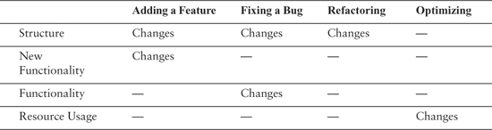
Effective commits
Why do we change software?
Add a new feature
Fix a bug
Refactoring
Optimizations
Good practice is to isolate changes
Easy to track, review and revert ☺
Each commit should do exactly only one thing!
Vice versa: a single change looks great in a single commit
© Working Effectively with Legacy Code, First Edition by Michael Feathers
Published by Prentice Hall, 2004

Slide 9
Commit message
Rule of thumb: try to explain changes in 50 characters
Will appear nicely in git backlog
You may describe your changes more detailed in next messages
Use imperative mood
Example:
Split InstrMemory to two interfaces (#617)
Since there are no backward dependencies, we can safely separate InstrMemory
to two interfaces: InstrMemory (which provides CPU-compatible interfaces) and
InstrMemoryCached (which provides same interfaces but manages decoding cache)

Slide 10
CI services
team needs a dedicated server + setup + maintainer
might be a problem in 1990s, but now he have cloud services
There are a lot of free of charge providers for open source
Most popular are:
Travis CI — provides Linux and OS X virtual machines
Appveyor — provides Windows virtual machines

Slide 11
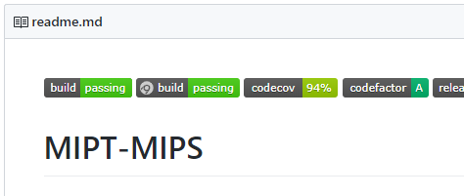
Installing Travis CI for C/C++ project
Register on https://travis-ci.com/
Authorize your GitHub account
Add a ‘.travis.yml’ file to the git root
Insert a status badge to README
language: cpp
compiler:
- gcc
- clang
os:
- linux
- osx
install:
- mkdir release && cd release
- cmake .. -DCMAKE_BUILD_TYPE=Release
script:
- make all unit-tests
- ctest --verbose

Slide 12
Installing Appveyor CI for C/C++ project
Register on https://ci.appveyor.com/
Authorize your GitHub account
Add a ‘.appveyor.yml’ file to the git root
Insert a status badge to README
image: Visual Studio 2017
environment:
matrix:
- build: msvc
platform: x86
CMAKEFILE: "Visual Studio 15"
- build: msvc
platform: x64
CMAKEFILE: "Visual Studio 15 Win64“
build_script:
- mkdir build
- cd build
- cmake ../simulator -G "%CMAKEFILE%"
- MSBuild .\mipt-mips.sln /p:Configuration=Release /p:Platform=%platform%

Slide 13
Drawbacks
You do not have full access to CI machine
hard to debug infrastructure issues (i.e. wrong folder name)
hard to find some external libraries or headers
some packages should be updated or installed
Resources are limited even for payed subscriptions
Security concerns for private projects

Slide 14
Side benefits of CI
Cross platform support:
developer uses only one platform, while CI verifies others
Code analysis:
code style checkers
static code analyzers
valgrind and other sanitizers
collection of test coverage
etc.

Slide 15
Homework
Setup CI for some of your projects
Use CMake/Makefile to run builds
Start with copy-pasting MIPT-MIPS configuration files

